Slide 1
Predicting Goals Scored by Clubs in English Premier League
Using AI and Machine Learning Algorithms

Slide 2
Introduction
Problem:
Predicting goals scored by clubs in English Premier League using AI and machine learning algorithms.
Motivation:
Leveraging the power of Machine Learning to analyze historical data and generate insights for predictions.
Target audience:
Football enthusiasts, betting enthusiasts, and sports analysts

Slide 3
Dataset
Dataset:
2020/2021 English Premier League season dataset from Kaggle.
Features:
Clubs, player names, nationality of players, goals, assists, expected goals, expected assists, passes attempted, cards, and other relevant information.
Data source:
Official Premier League websites or reputable sports data providers.

Slide 4
Preliminary Analysis and Exploratory Data Analysis
Total number of players in the 20/21 EPL season: 532.
Club with the highest number of registered players: West Bromwich Albion (30 players).
Club with the fewest registered players: Leeds United (23 players).
Total goals scored in the 20/21 EPL season: 986.
Total goals assisted in the 20/21 EPL season: 685.
Age distribution analysis of Premier League players
Majority of the players 207 and 181 were in their peak years that is between the ages of 25-29, then 20-24

Slide 5
Methods
ML Algorithm Selection:
Consideration of various ML algorithms based on performance metrics such as Mean Squared Error (MSE) and R-Squared scores.
Model Evaluation:
Linear Regression and Random Forest Regression algorithms used for predicting goals scored by clubs. Evaluation based on MSE and R-squared scores.
Feature Selection:
Initial selection of features: 'Passes_Attempted', 'Perc_Passes_Completed', 'xG', and 'xA'. Conduct feature selection process to identify the most important features. Final selection: 'xG' and 'xA' as primary predictors.

Slide 6
Results
Comparison of model performance:
Linear Regression:
MSE (Mean Squared error): 12.4536
R-squared Score: 0.8045
Random Forest Regression with Scaling:
MSE: 45.5739
R-squared Score: 0.2844
Interpretation of MSE and R-squared scores.
Selection of Linear Regression model as the preferred choice for this prediction task.

Slide 7
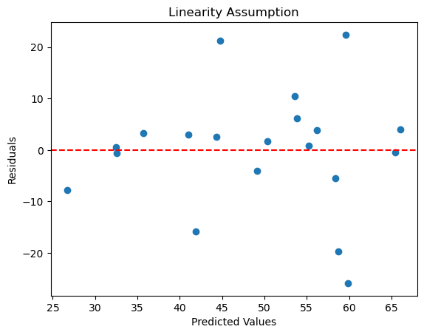
Results (continued)
Retrained model and residual plot analysis.
Residual plot characteristics indicating good overall performance.
Model predictions(67, 55, 61, 63) vs. actual goals scored by clubs(53, 33, 47,52).

Slide 8
Conclusion
Summary of the study's objectives and methodology.
Linear Regression model outperformed the Random Forest Regression model.
Accuracy and explanatory power of the linear regression model (MSE: 12.4536, R-squared Score: 0.8045).
Implications of the study for football enthusiasts, betting enthusiasts, and sports analysts.
Potential for further research and refinement of the model.

Slide 9
Limitations and Future Work
Potential violations of linearity assumptions in the model.
Need for further investigation and refinement.
Consideration of additional features and algorithms for improved predictions.

Slide 10
Thank you

